Slide 1
ORIE 5741 LEARNING WITH BIG MESSY DATA
Can We Predict Equity Index Volatility Using Machine Learning?
Niharika Dalsania (nd322)
Sukriti Kumar (sk3335)
Vishad Bhalodia (vmb39)

Slide 2
Why Predict Volatility?
Financial markets
Highly nonlinear (stochastic)
Low signal-to-noise ratio
Difficult to predict stock returns
Easier to predict volatility

Slide 3
What is the plan?
Feature Engineering and build models
1. Fill missing data in the time series and standardize the data feature matrix.
Outline scope of future improvement
1. Explore additional complex models using stacking, meta-learning and dynamically adjusting models for superior out of sample performance.
1. Predict daily realized volatility of S&P 500 Index using different models and compare the predictions with the GARCH model (benchmark).
Predict and identify the best model
1. Review academic literature and identify relevant features.
Identify features and collect data
2. Collect time series data for each of the features and combine them in a single table.
3. Build linear and non-linear models (with hyperparameter tuning) for prediction of realized volatility.
2. Formulate a benchmark GARCH model for modelling volatility.
2. Break the full dataset over different market regimes and build separate models for each time period.
2. Provide a design for select future models.

Slide 4
Choice of Features
Volatility lag variables
CBOE volatility (VIX) index
China (SSE) and Taiwan (TAIPEX) index returns
US 1-month T-bill rate
Ex-dividend dates
Recession Indicator
ADS Business Conditions index
Economic Policy Uncertainty Index (EPU)

Slide 5
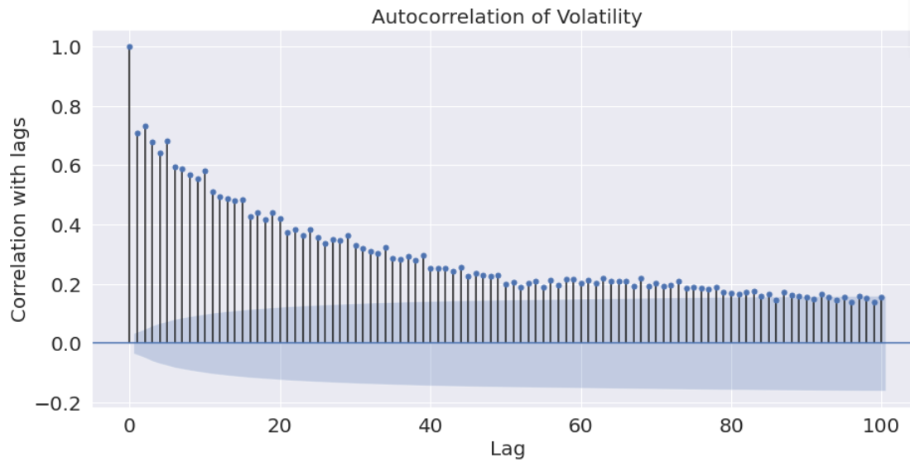
1. Volatility Lag Variables
5-day lag
20-day lag

Slide 6
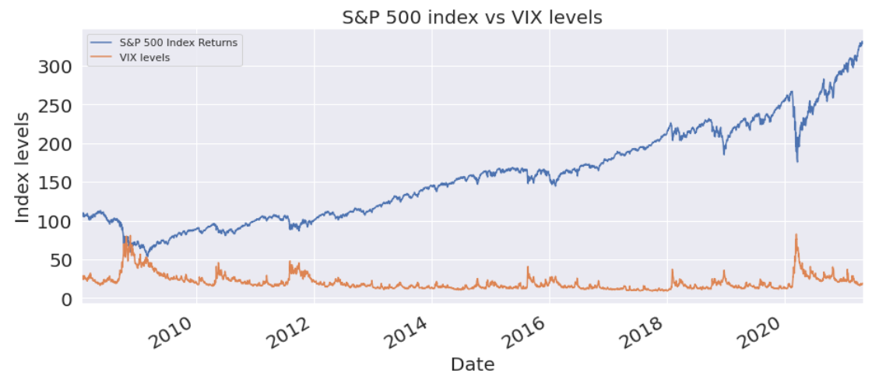
2. CBOE Volatility (VIX) Index

Slide 7
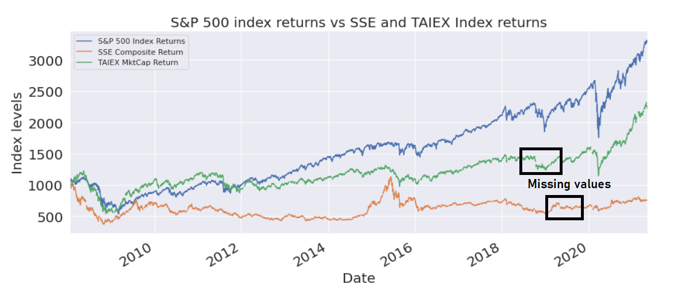
3. China (SSE) / Taiwan (TAIPEX) Index Returns

Slide 8
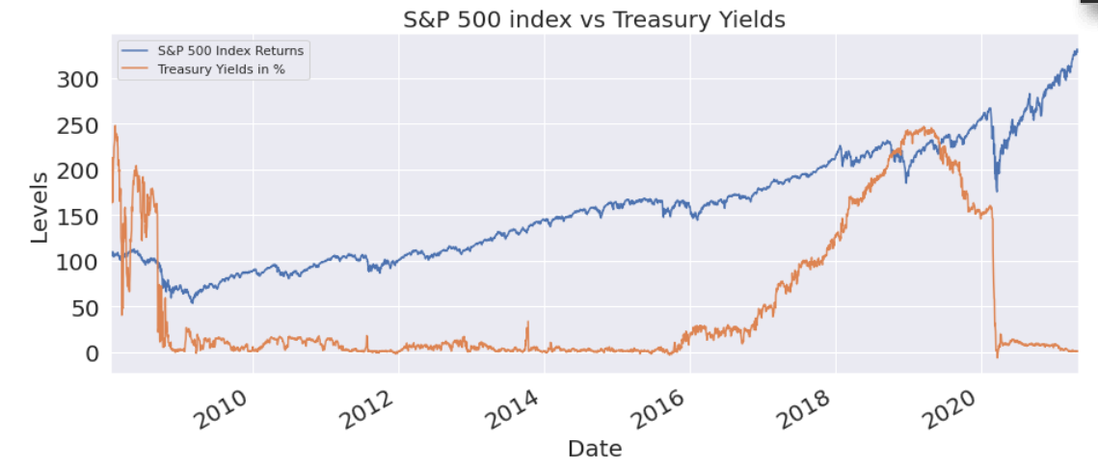
4. US 1-month T-bill rate

Slide 9
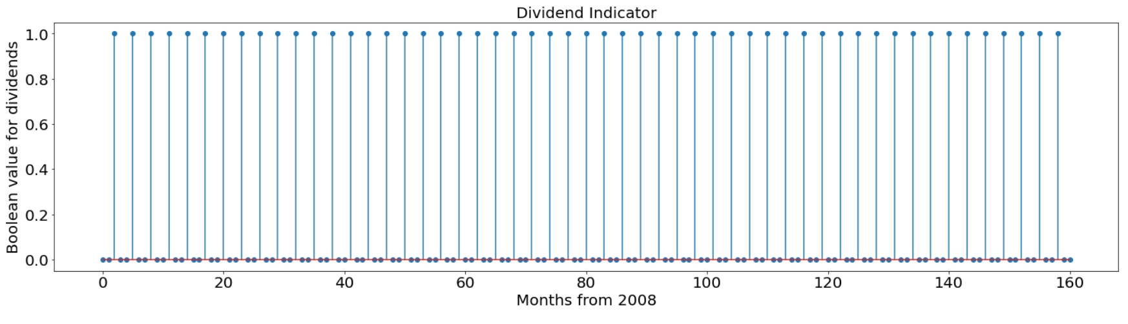
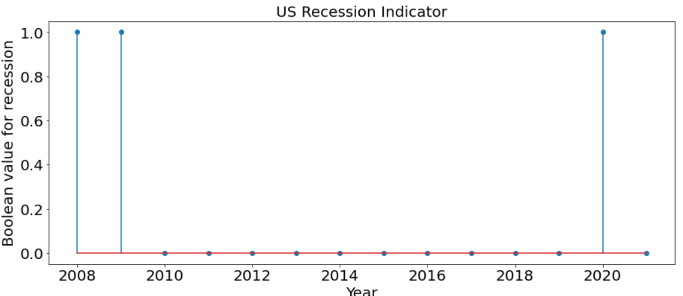
5 & 6. Dividend & Recession Indicators

Slide 10
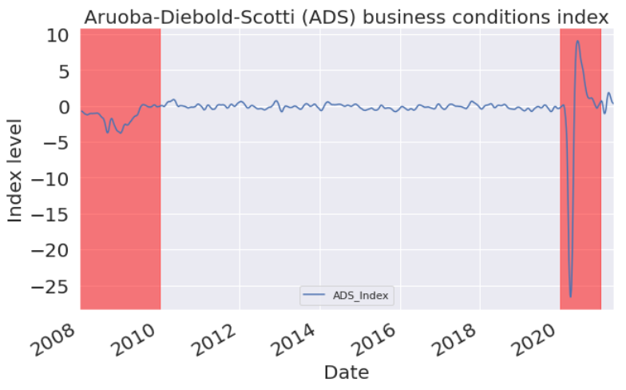
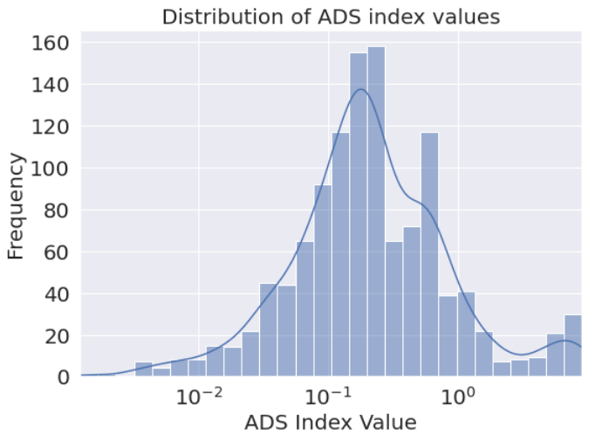
7. ADS Business Conditions Index

Slide 11
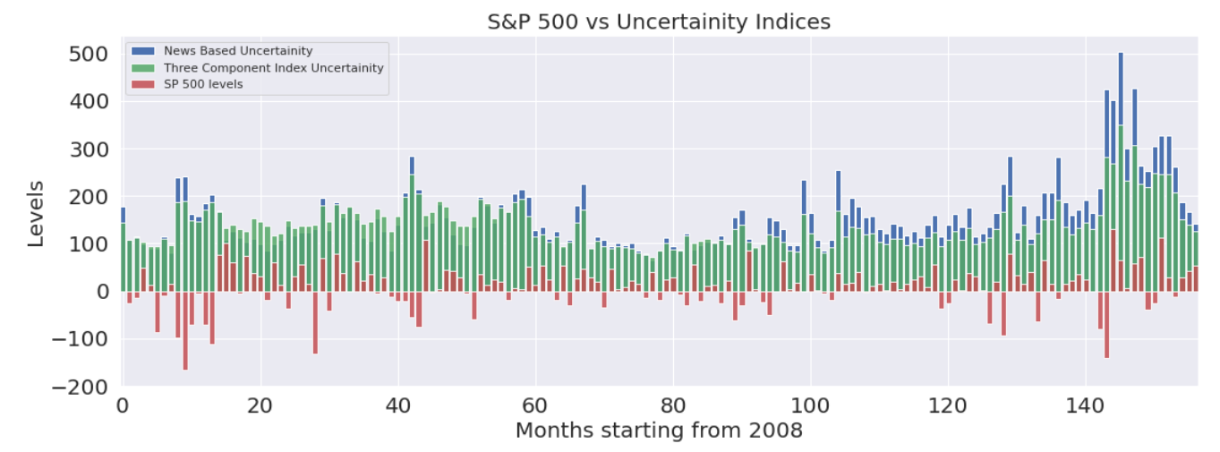
8. Economic Policy Uncertainty (EPU) Index

Slide 12
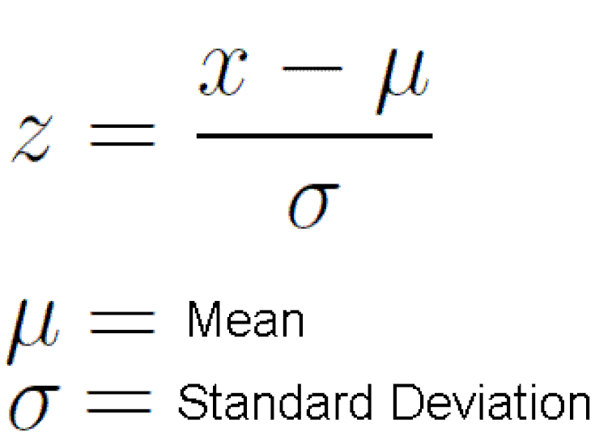
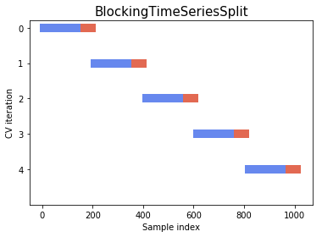
Preparing the data for ML modelling
1. Fill missing values and standardize the data
2. Split the data into train and test set
Missing values in returns/index values: Holiday treatment (different for US, China and Taiwan).
Combine data with varying frequencies: Monthly data needs to be joined with daily data
Boolean Features: For the recession and dividend payout features, we convert them to a Boolean value and realign them to join with daily data.
Finally, standardize the data: We use the industry standard z-score standardizing technique to de-mean data to bring them on a uniform scale.
Time series data cannot be split into random train/test sets (using built in sklearn API). Thus, we split the data such that historical data (2008- 2018 roughly) is our training set and the recent data from 2019 onwards is our test set.
We have not specified an explicit validation set. However, for hyperparameter tuning using random search, we utilized a novel approach to making cross validation folds which retains the time series structure.

Slide 13
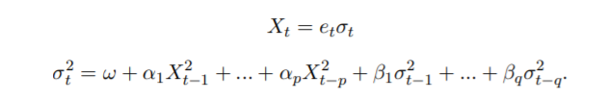
Baseline GARCH Model
For the purposes of a baseline model, we have used the finance industry wide used GARCH model for prediction of realized volatility.
We have thus considered the GARCH model for comparing the model performance of our linear and non-linear models. The GARCH (p,q) model is modelled as shown below, where p is the number of lagged return terms being considered and q is the number of lagged error variance terms being considered with itself.

Slide 14
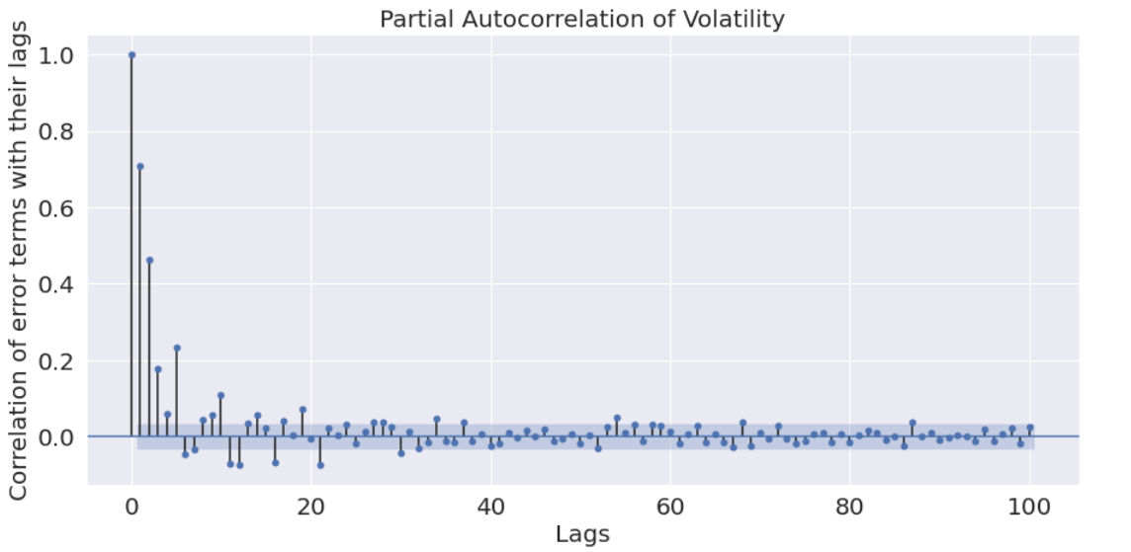
Baseline GARCH Model
As our benchmark/baseline model, we have used the GARCH (2,1) model. The parameters p and q for the GARCH model have been estimated using the Autocorrelation Function (ACF chart from the EDA section) as well as the Partial Autocorrelation Function (PACF)
1-day lag in error terms

Slide 15
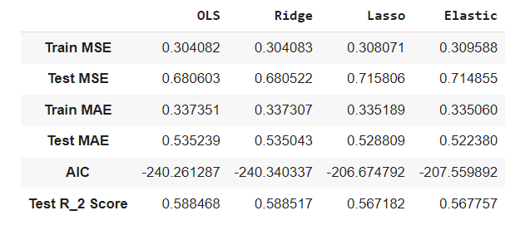
Linear Models
Four linear models: Ordinary Least squares, and regularized models – Ridge regression, Lasso regression and Elastic net regression.
Correlation heat map between our features show multicollinearity and to deal with multicollinearity we use regularized models as well as dropped some of our features for linear models. We have also transformed our features to include them as part of our linear model independent variable. The featured variable is the ratio of total volume of all the contracts traded in a day to the sum of the news-based policy uncertainty index as well as the three component uncertainty index.
Of all the linear models we considered, ridge regression performs best according to test MSE and elastic net performs the best according to MAE. The metrics table showing the effectiveness of our models is as below:

Slide 16
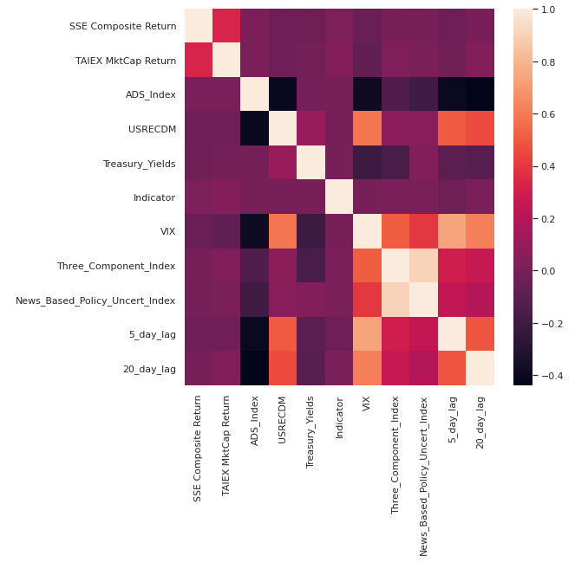
Linear Models: Exploring co-linearity of features
EPU Index (two features) — high positive correlation with VIX
ADS Business Conditions Index — high negative correlation with VIX
Compare linear models with all features vs dropping the collinear features

Slide 17
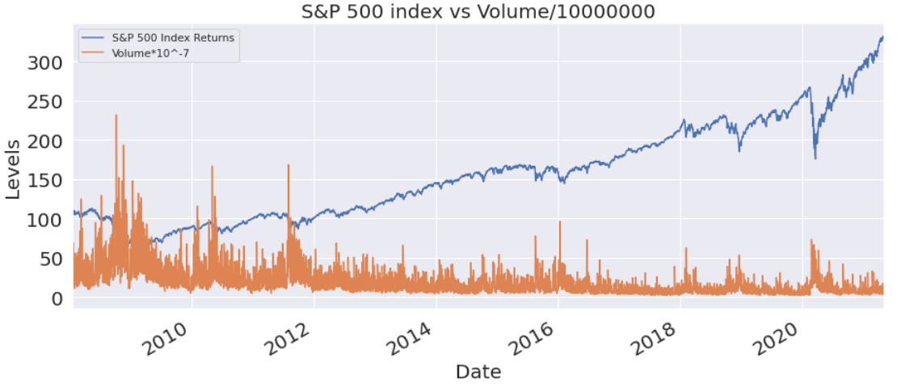
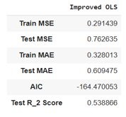
Linear Models: Feature Engineering
We have transformed the uncertainty indices as well as the volume of all S&P 500 contracts traded in a day into a new feature. The new feature is defined as:
$$Volume to Uncertainty = \frac{Volume}{News based policy uncertainty index + Three component uncertainty index}$$

Slide 18
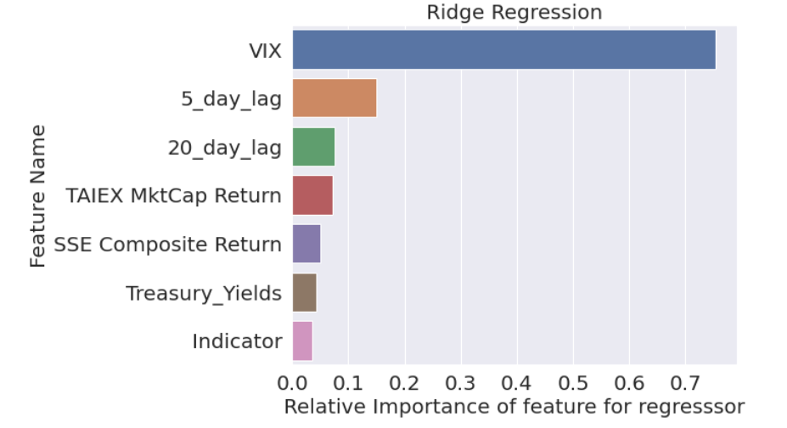
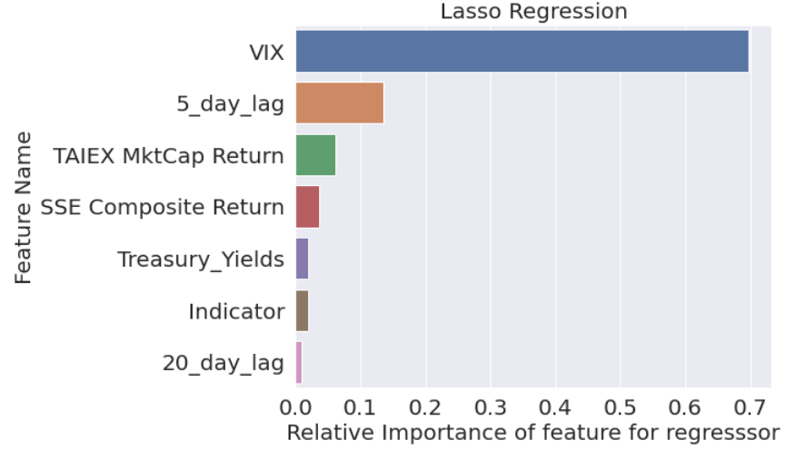
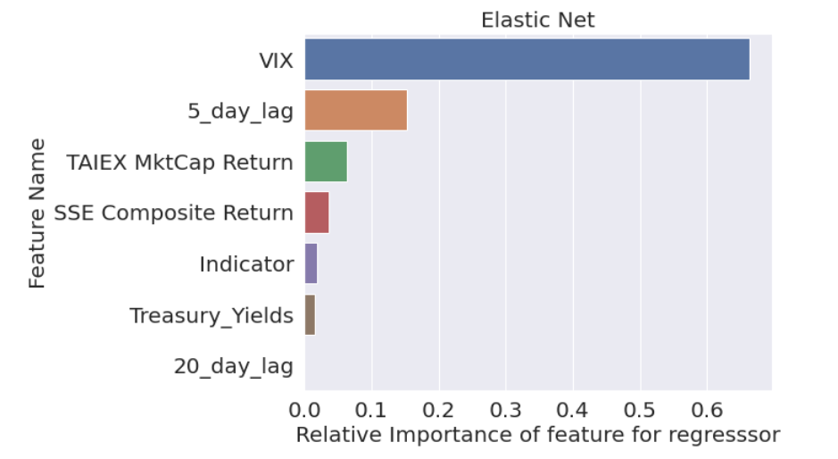
Linear Models – Feature Importance

Slide 19
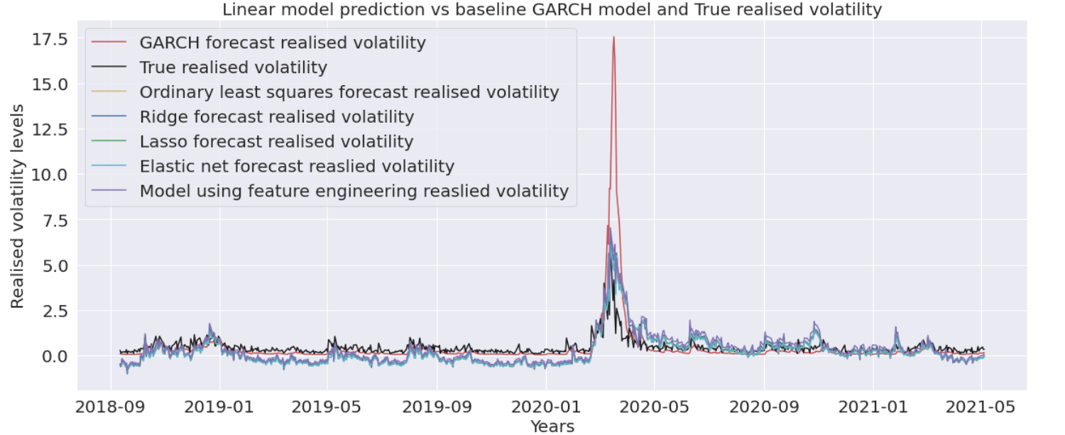
Linear Models - Predictions

Slide 20
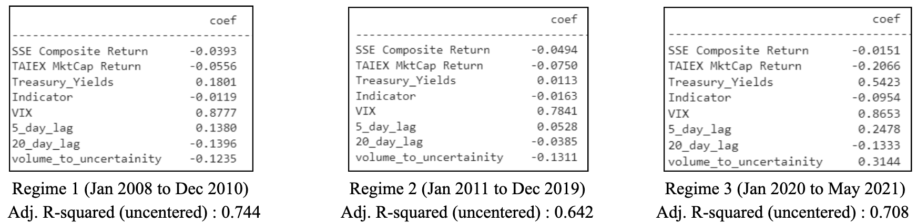
What happens in different time regimes?
To check how the model performs for various market regimes, we separated the entire time series into 3 separate periods of financial crisis of 2008-2009, the covid crisis of 2020-2021 as well as the rally period in between and compared how the coefficients of the predictive linear model changed between them.
It was observed that building separate tuned models for different regimes can enhance the predictive power of the models. We also discuss in detail about improvements on this empirical setup for future improvements (including stacking models and dynamically adjusting models)

Slide 21
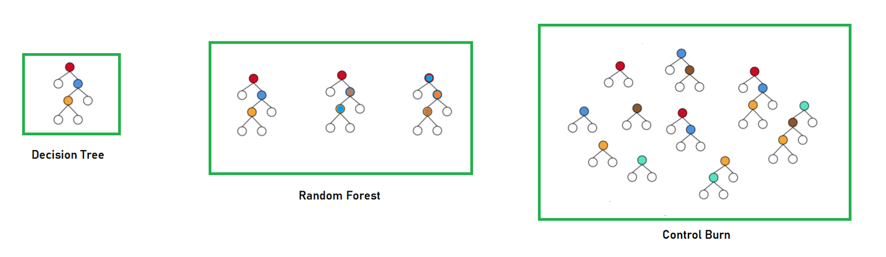
Non-Linear Models
Three nonlinear models used
Advantages
do not have to deal with multicollinearity manually - models take care themselves
easy to prevent overfitting of the data by hyperparameter tuning
Hyperparameter tuning – used cross validation sets with blocking split time series split

Slide 22
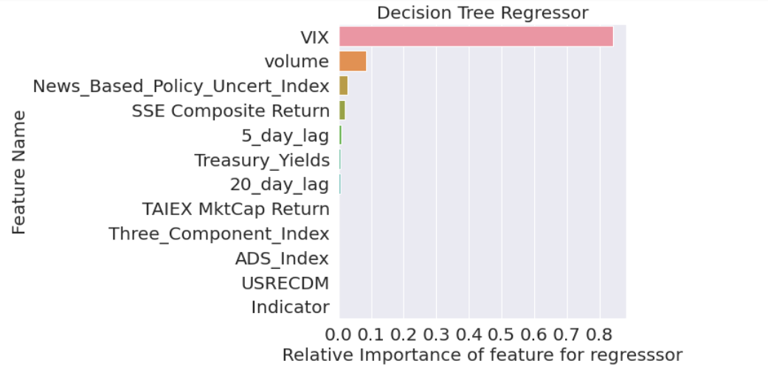
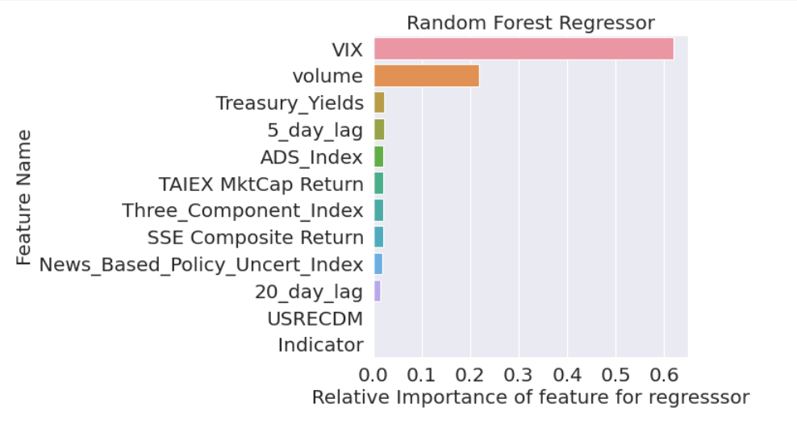
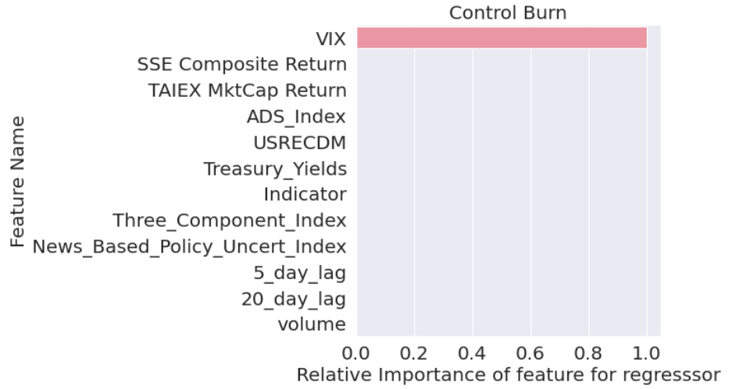
Non-Linear Models : Feature Importance

Slide 23
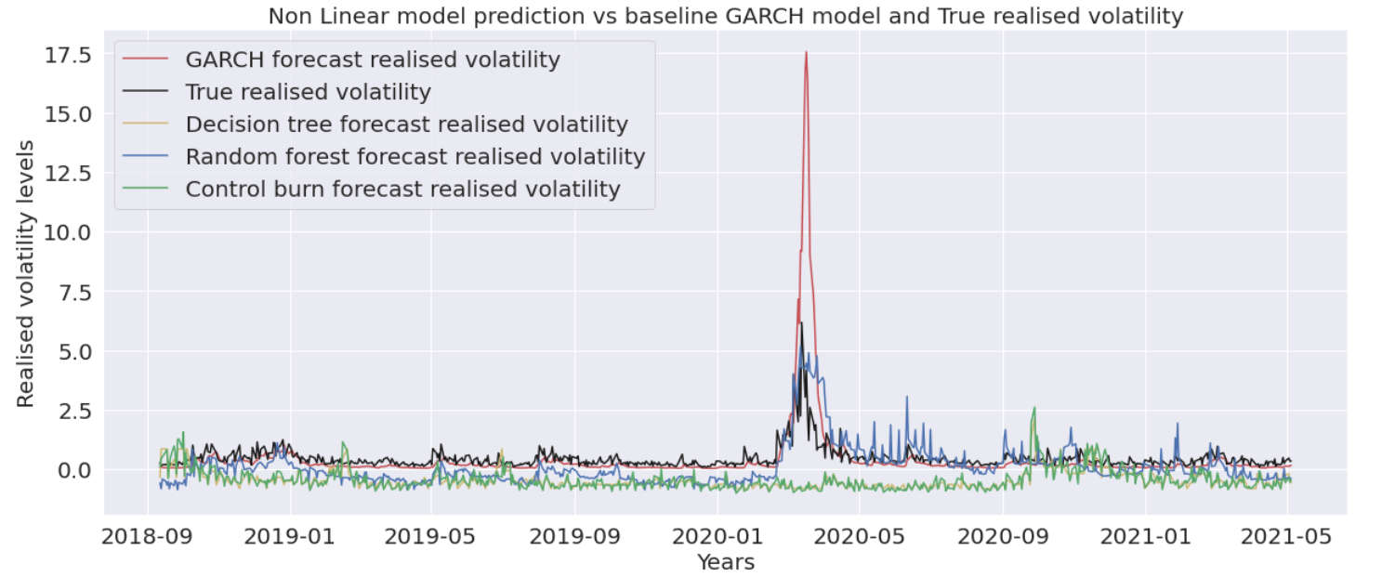
Non-linear Models : Performance

Slide 24
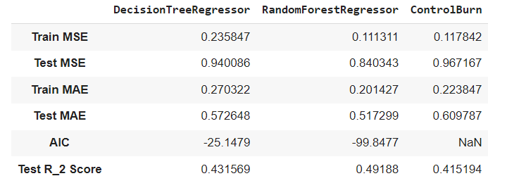
Non-Linear Models : Comparison
Random forest performs best according all to all the considered metrics

Slide 25
Overall, who wins?
All the tested models have better predictive power than the widely used GARCH model
Even in outlier situations, the predicted values are much closer to the true realized volatility as opposed to the GARCH model predictions which shoot through the roof.
Ridge Regression performs best according to Test MSE, AIC and R2 score
Random Forest performs best according to Test MAE.
Overall, linear models do better than non-linear
Non-linear models which are related to the time component are not able to generalize well (they overfit in periods of low volatility and underfit in periods of high volatility).

Slide 26
Is fairness an issue in this model?
Fairness of the models is not relevant to our realized volatility prediction model.
Discrimination/Bias: inputs include historical macroeconomic data and the index returns of public indices for global markets - no bias or discrimination embedded.
Legal requirements: using publicly available historical data so no legal requirements are violated. Also, outputs only affect our trading/research, so does not violate any SEC laws.
Harm from False Positives and False Negatives: would lead to inaccurate volatility prediction and it may affect our the trading strategy
Effect of errors change on data distribution in future: model uses lagged terms of realized volatility, the errors in the prediction will lead to errors in the future as well but only for the trading strategies employing our model - no price distortion in market prices

Slide 27
Is this model a weapon for Math Destruction?
Not a Weapon of Math Destruction - do not fit the three main criteria of a Weapon of Math Destruction:
Has easily measurable outcomes, goal of our model is not ambiguous and can directly measure our results
Predictions do not have negative or unintended consequences, do not affect the wellbeing of others or the health of any of the companies we performed analysis on
Does not create feedback loops

Slide 28
What next?
Daily volatility is quite noisy and hard to lock down.
For better accuracy, try weekly/monthly volatility (generally used by portfolio managers)
More powerful/complex models for better accuracy
Stacked ensemble models: ensemble of a well-chosen collection of strong yet diverse models
Deep neural networks: multi-layer LSTM models to fit and predict volatility with a high predictive accuracy - tradeoff with complex design as well as fine tuning of hyperparameters to work well
Dynamic switching models (meta-learning): switch models based on bull/bear markets signals dynamically to ensure high predictive accuracy - ensures that the model is dynamically chosen depending on the market conditions enabling the trading strategies using our model to make better decisions
Very difficult task (even for institutional funds) - still in the nascent research stage.

Slide 29
In a nutshell...
Predictive model for realized volatility uses macroeconomic variables and select market index returns along with lagged realized volatility values to depict the market conditions.
Analyzed 10+ years of data which captures the evolution of the market covering some of the big crises like the financial crisis of 2008-2009 and the Covid crisis of 2020-2021.
Performance highlights:
Predictive power of our linear models was better than the non-linear models - shown using multiple metrics like MSE, MAE, R2 score and AIC
Best model for this problem, on this data, according to us - Ridge regression!
Learning with Big Messy Data (ORIE 5741)

